Slide 1
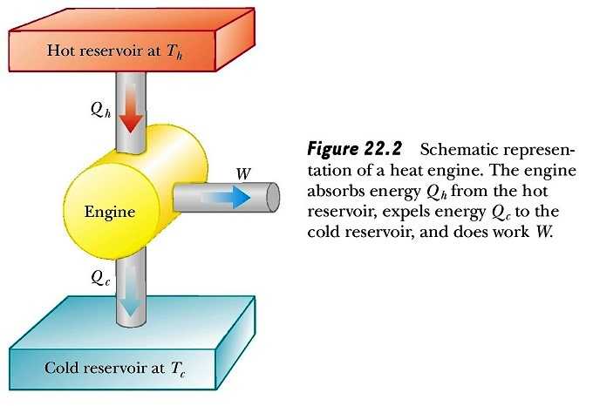
Lecture # 7
Second law of Thermodynamics

Slide 2
Content
Heat engines
The Carnot Cycle and the Efficiency of Engines
Heat Pumps and Refrigerators
The Second Law of Thermodynamics.
Entropy.
Real gases. Van-der-Waals equation.

Slide 3

Heat engines
A heat engine is a device that takes in energy by heat and, operating in a cyclic process, expels a fraction of that energy by means of work.
The thermal efficiency e of a heat engine
This Equation shows that a heat engine has 100% efficiency (e = 1) only if
|Q_{c}| = 0, that is, if no energy is expelled to the cold reservoir.
Notes:
A heat engine is a device that takes in energy by heat and, operating in a cyclic process, expels a fraction of that energy by means of work. Yes device that can be modeled as a heat engine is the internal combustion engine in an automobile. This device uses energy from a burning fuel to perform work on pistons that results in the motion of the automobile.
It is useful to represent a heat engine schematically as in Figure. The engine absorbs a quantity of energy |Q_{h}| from the hot reservoir. For the mathematical discussion of heat engines, we use absolute values to make all energy transfers by heat positive, and the direction of transfer is indicated with an explicit positive or negative sign. The engine does work W_{eng} (so that negative work W = -W_{eng} is done on the engine) and then gives up a quantity of energy |Q_{c}| to the cold reservoir.

Slide 4
The Carnot Cycle and the Efficiency of Engines
It was important to regulate an engine to develop its maximum power output and to determine what that output was.
Watt accomplished this with a technique he developed and used privately for many years. Though steam engines were considerably improved by Watt and others, the basis for understanding the general principles of heat engines did not come until 1824, when the French engineer Sadi Carnot (1796-1832) published a treatise on this subject.
In doing so, Carnot formulated the basic ideas of thermodynamics. He said that all movements were ultimately due to heat. It made no difference whether they occurred in natural phenomena, such as rain, storms, earthquakes, and volcanos, or in mechanical devices such as steam engines

Slide 5
The Carnot Cycle and the Efficiency of Engines
Carnot proposed an ideal heat engine that operates cyclically and reversibly between two temperatures.
The ideal Carnot engine sets an upper limit on the efficiency of all real engines, including steam engines, Diesel and gasoline (Otto) engines, jet engines, and nuclear reactors. Furthermore, studies of the theoretical Carnot engine indicate some of the factors that affect the efficiency of real engines.

Slide 6
The Carnot Cycle and the Efficiency of Engines
Carnot engine consists:
Cylinder containing the working substance.
A hot body of infinite thermal capacity, called a heat reservoir, supplies heat. (This reservoir can be approximated by any source of heat)
The cold body, called a heat sink, is also of infinite thermal capacity so that it can absorb heat without raising its own temperature. (This sink can be approximated by any large body, such as the ocean)

Slide 7
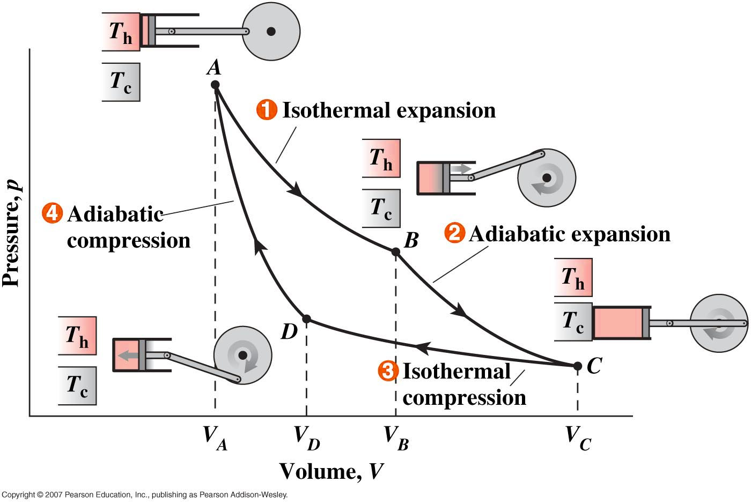
The Carnot Cycle and the Efficiency of Engines
The Carnot cycle consists of four reversible processes, two isothermal and two adiabatic:
Step 1. We start the cycle with the cylinder in contact with the heat reservoir, where the working substance (gas) takes in an amount of heat Q_{h} at a high temperature T_{H}.

Slide 8
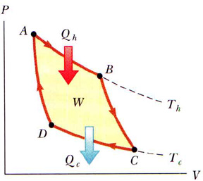
The Carnot Cycle and the Efficiency of Engines
Step 2. The cylinder is then moved to the insulating body, where the heat input is zero. The load on the piston is reduced and the gas is allowed to expand, this time along an adiabatic curve (B to C).
Step 3. Next the cylinder is moved to the heat sink. Here the gas undergoes an isothermal contraction (С to D) in which an amount of heat Q_{c} expelled to the cold reservoir at temperature T_{c}.
Step 4. In the final step of the Carnot cycle, the cylinder is moved back to the insulating body. The load on the piston is increased and the gas undergoes an adiabatic compression (D to A).

Slide 9
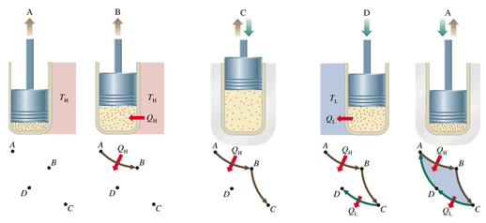
The Carnot Cycle

Slide 10
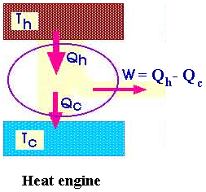



The Carnot Cycle and the Efficiency of Engines
By the first law of thermodynamics, the work done must equal the net heat flow into the cylinder:
W = Q_{H} - Q_{C}
Where Q_{H} and Q_{C} are taken to be positive quantities. The process is shown schematically in.
We define the thermal efficiency of any system, such as a machine, to be the ratio of the work done to the heat input:
For an ideal gas the internal energy is proportional to the Kelvin temperature.

Slide 11
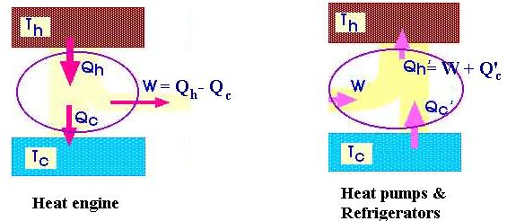


Heat Pumps and Refrigerators
By reversing the direction of the Carnot cycle, we can put work into the system and transfer heat from a low temperature to a higher one. A system operated in this manner is called a refrigerator
and is called the coefficient of performance (c.p.):
with ideal gas as the working substance, this becomes

Slide 12


Heat Pumps and Refrigerators
An air conditioner is a refrigerator that is designed to take heat from within a house and exhaust it to the outdoors. When such a system is reversed so that it cools the outdoors and delivers heat to the inside of the house, it is called a heat pump. The coefficient of performance of a heat pump is defined to be the ratio of the heat delivered inside the house (the high temperature reservoir) to the work supplied:
In terms of temperatures, the coefficient of performance becomes

Slide 13
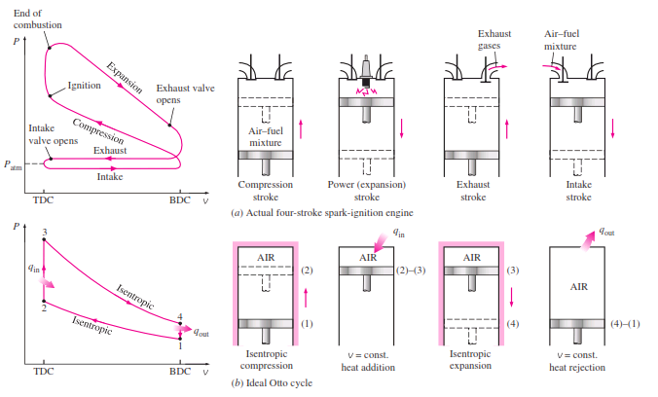
Gasoline and Diesel Engines
Otto cycle (Gasoline Engine)

Slide 14
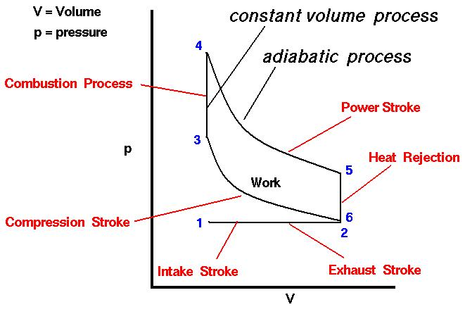

Slide 15
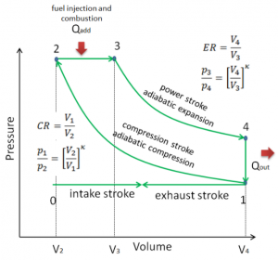
Diesel cycle

Slide 16
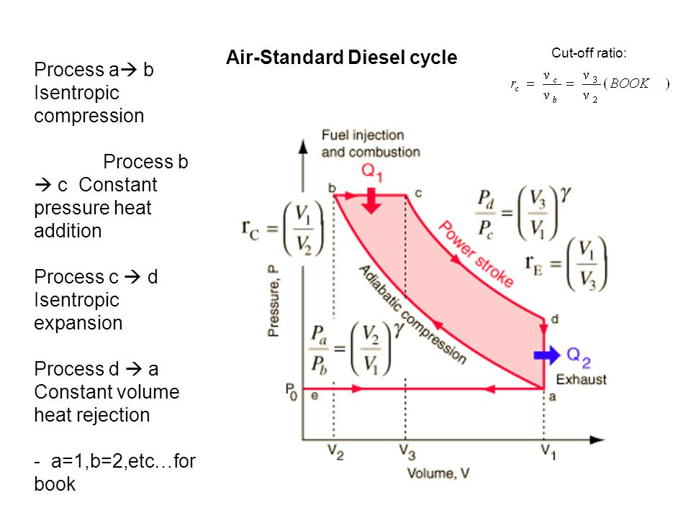

Slide 17
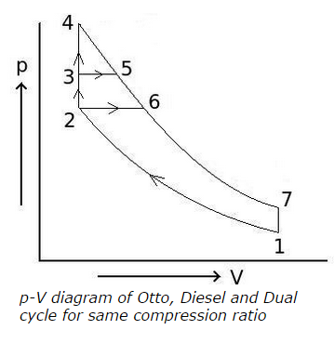

Slide 18
The Second Law of Thermodynamics & Entropy
There are three formulations of the second law:
Clausius statement of the second law: Heat cannot, by itself, pass from a colder to a warmer body.
Kelvin statement of the second law: It is impossible for any system to undergo a cyclic process whose sole result is the absorption of heat from a single reservoir at a single temperature and the performance of an equivalent amount of work.
We can gain additional insight into the meaning of the second law of thermodynamics by considering it from a standpoint first introduced by Clausius in 1850. He introduced a new thermodynamic state variable called entropy, which has two Greek roots and means much the same as "turning into “.
Entropy is a measure of how much energy or heat is unavailable for conversion into work.

Slide 19


The Second Law of Thermodynamics
& Entropy
When a system at Kelvin temperature T undergoes a reversible process by absorbing an amount of heat Q, its increase in entropy ΔS is
or
Notice that we are defining entropy for a reversible process, which does not occur in nature. However, for our purposes, we can use this definition for processes that are approximately reversible.
3. A more generalization principle, discovered by Clausius: In any process the entropy of the system increases or remains constant.
(This is another way of expression of the second law.) Entropy remains constant only in the case of reversible processes.

Slide 20
The Second Law of Thermodynamics & Entropy
If we have two bodies at different temperatures - say, a hot stove and a block of ice - we can connect a heat engine between them and extract useful work.
If, instead, we place the two bodies in direct thermal contact, they will come to thermal equilibrium. In agreement with the first law of thermodynamics, the total energy content of the stove and the ice is the same before contact as that of the stove and water (melted ice) after they have been placed in contact.
However, once they reach equilibrium, we cannot separate them again and expect to extract work from them with a heat engine. Something has changed, even though the total energy has not. What has changed is the availability of the energy to do work. An increase in entropy means a decrease in the energy available to do work, not a decrease in the total energy.

Slide 21
The Second Law of Thermodynamics & Entropy
Ludwig Boltzmann (1844-1906) showed that an increase in the entropy of a system or substance corresponds to an increased degree of disorder (chaos) in the atoms or molecules composing the substance. The most probable—that is, the most statistically favored arrangement of molecules is the one with the most molecular disorder.

Slide 22
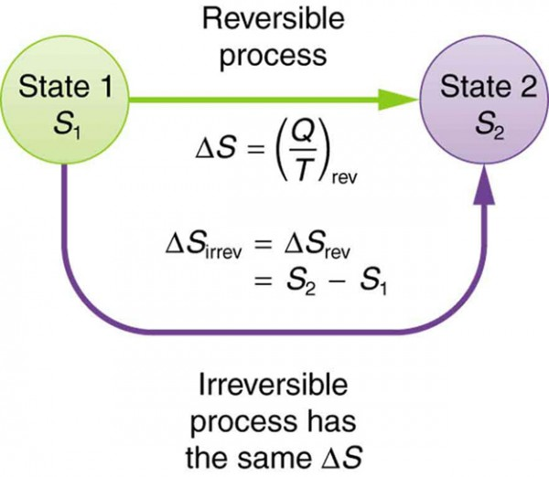

Slide 23
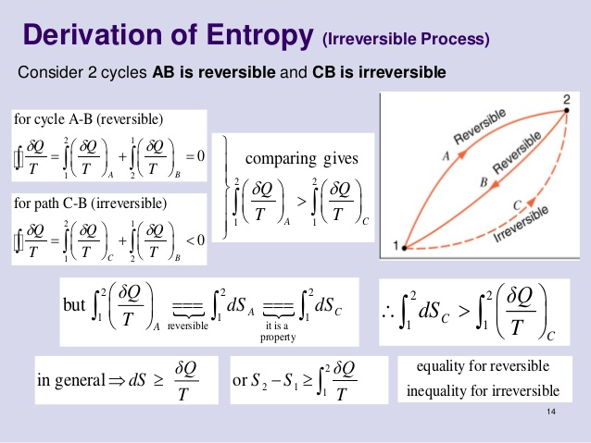

Slide 24
Energy and Thermal Pollution
If the entropy principle is true throughout the universe, we can envision some time in the far distant future when everything m the universe will have reached a uniform temperature. No heat could flow, no work could be done, and no change in energy or motion could take place. Neither engines nor plants nor animals would be able to extract energy. This possible occurrence is often called the heat death of the universe.
There are several approaches to solving, or at least lessening, the problem of thermal pollution. One approach in which active research is going on is the development of alternative energy sources. The techniques being studied include the harnessing of wind power, tidal power, solar power, ocean temperature differences, and a host of other ingenious ideas. A second approach to reducing thermal pollution involves measures for saving energy, from better building insulation to smaller, more efficient cars.

Slide 25
The van der Waals Equation
The agreement between the observed and predicted behavior of real gases is good near atmospheric pressure and ordinary temperatures.
Deviations from the predictions are greatest when the pressure is very great or the temperature is very low.
At the extremes of these conditions, the gases condense to liquids.
We can take account of certain types of molecular interactions and of the nonzero size of the molecules by making modifications to the equation of state of an ideal gas.

Slide 26
The van der Waals Equation
The first major step in this direction was taken in 1873, when the Dutch physicist J. D. van der Waals (1837-1923)
(P + an²/V²)(V – nb) = nRT
This equation, called the van der Waals equation. The constant b is called the covolume and nb is of the order of magnitude of the volume actually occupied by the molecules.
The interaction between the molecules is taken into account in a very general way by the constant a. Both a and b must be determined experimentally and are different for different gases.

Slide 27
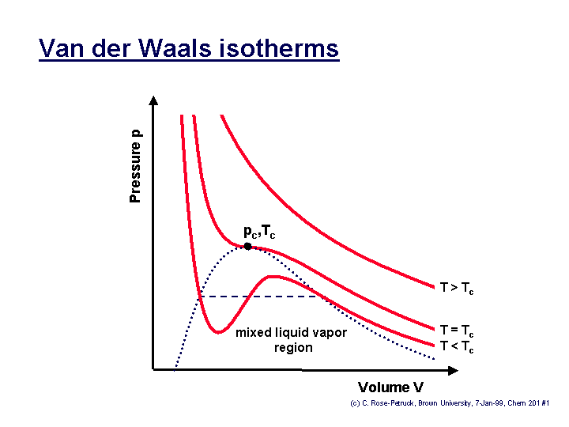
The van der Waals Equation
The lines of constant temperature are called isotherms.
Two extreme points approach each other and merge with the inflection point
extreme points
Inflection point

Slide 28
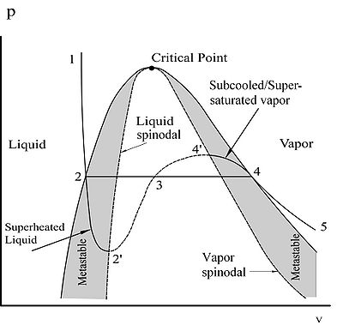

Slide 29
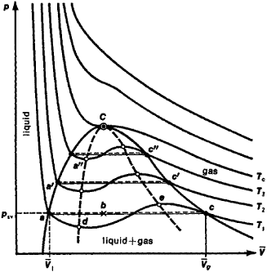
Look at pictures and try to understand followings.
Critical point.
Region where we can use both words gas and vapor.
Region where we have to use only gas
Region where gas and liquid present simultaneously.
Region where matter is in liquid phase.
Metastable states.
Superheated liquid.
Subcooled/supersaturated vapor.

Slide 30
